Slide 1

Hiring the Best:
Best Practices Human Resources Toolkit
2014 GSBA/GSSA Preconference Workshop
December 4, 2014

Slide 2
Agenda
Toolkit Overview
Toolkit Walkthrough
  Recruitment
  Selection
  Retention
Q & A

Slide 3
Toolkit Overview
The Toolkit offers best practices and resources for improving human capital outcomes in three core areas
  Recruitment
    Reaching and attracting candidates
  Selection
    Identifying and selecting the best
  Retention
    Retaining your top teachers

Slide 4

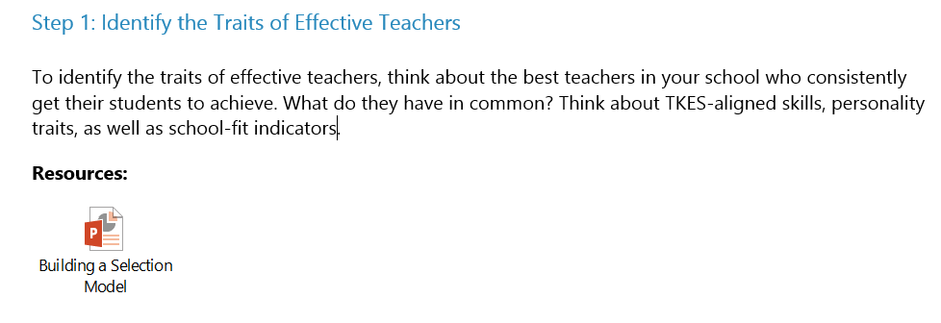
Toolkit Overview
Each section is designed as a “roadmap” with step-by-step guidance and ready-to-use resources for that area of Human Capital Management.

Slide 5
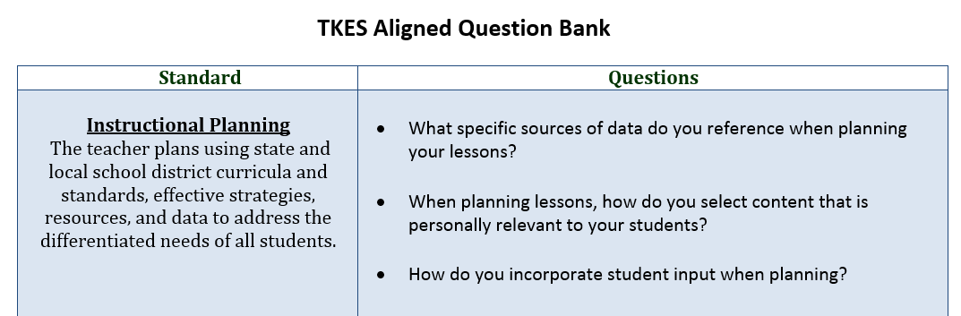
Toolkit Overview
Simply follow the steps and use the resources as needed to improve your Human Capital practices and outcomes
Example:
Need interview questions for a stronger selection process? Follow the steps in the Selection Roadmap, then open the embedded TKES Question Bank for concrete interview questions you can use tomorrow.

Slide 6
Agenda
Toolkit Overview
Toolkit Walkthrough
  Recruitment
  Selection
  Retention
Q & A

Slide 7
Teacher Recruitment Roadmap

Recruit top talent, so you have the best pool of teachers to select from.

Slide 8
Best Recruitment Practices
Use compelling marketing messages and materials to attract teaching talent
  Developing a school “pitch”
  What sets a school apart?
  What traits is a leader looking for in teachers?

Slide 9
Best Recruitment Practices
Use your recruitment funds strategically
  Target hi-yield on-line recruitment sources
  Education job fairs

Slide 10
Best Recruitment Practices
Good teachers can come from anywhere
  Traditional candidates
  Non-traditional candidates
  Career changers

Slide 11
Best Recruitment Practices
Limit unnecessary barriers to entry and application requirements
  Documentation required prior to interview

Slide 12
Recruitment Resources
Creating marketing messages
Developing marketing materials
Sample job postings
Building on-line recruiting presence
  Highest yield recruitment sources
Creating a web presence
Rural recruitment tips
Specialized and critical field candidates

Slide 13
Teacher Selection Roadmap
Select teachers who will be the best fit for your school.

Slide 14
Best Selection Practices
Identify the traits of effective teachers
  Performance Standards (TKES)
Create selection tools to assess effective teaching traits
Hire early and efficiently
Use selection data to inform new hires and design professional development

Slide 15
Selection Resources
Selection activities
Demo lessons
TKES Interview question bank
Hiring committees
  Hiring committee worksheet
Declaration of Intent
  Sample form
Best hiring practices
  Early selection and hiring timeline

Slide 16
Teacher Retention Roadmap
Recognize and retain your top performers and best teachers.

Slide 17
Best Retention Practices
Understand why top teachers leave their schools
Accurately identify your highest performing teachers
Encourage your best teachers to stay
Create a retention plan

Slide 18
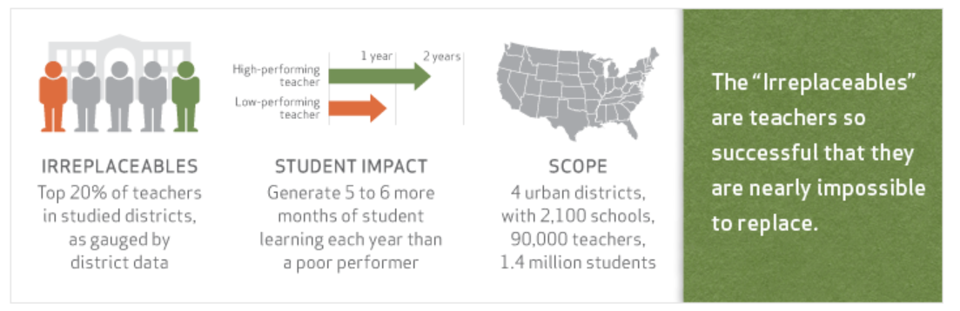
Best Retention Practices
The attrition of irreplaceable teachers can be easily prevented.

Slide 19
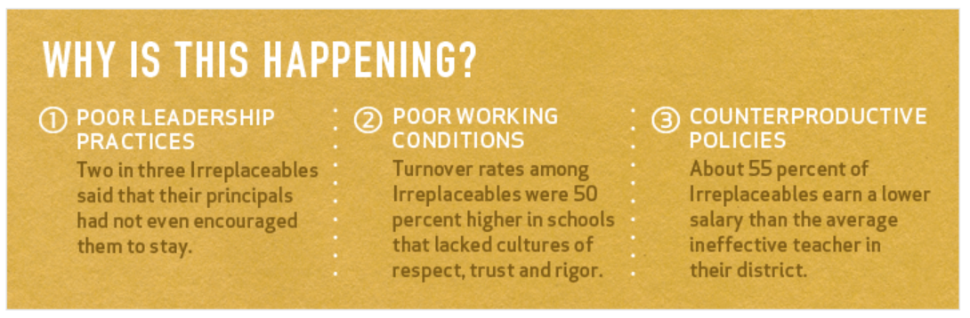
Best Retention Practices
Top and bottom performing teachers are retained at strikingly similar rates.
Ideally, high performing teachers would be kept at much higher rates than low performing teachers, who should be counseled out of the profession if they cannot rapidly improve.

Slide 20
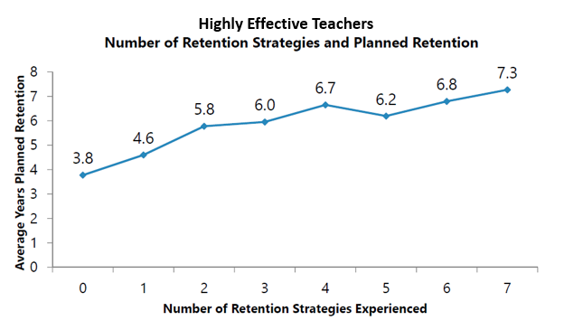
Best Retention Practices
Create a retention plan using resources and retention strategies targeted to your best teachers.
Above: Teachers ranked eight retention strategies from 1 (unimportant) to 5 (very important)
Above: Those effective teachers who experienced more retention strategies plan to stay at their schools longer.

Slide 21
Retention Resources
Retention planner
Retention strategies
10 Ways Principals can keep Top Teachers
Additional resources:
  Fast Start: Training Better Teachers Faster
  Leap Year: Assessing and Supporting Effective First-Year Teachers
  5 Tips for Putting New Teachers on the Right Path

Slide 22

Questions

